Slide 1

PRESENTATION TITLE
UNEMPLOYMENT IN INDIA
1.

Slide 2
Prepared By:
Aditya Sonawane (21101) and Shubham (21118)
E1 Batch.
2.

Slide 3
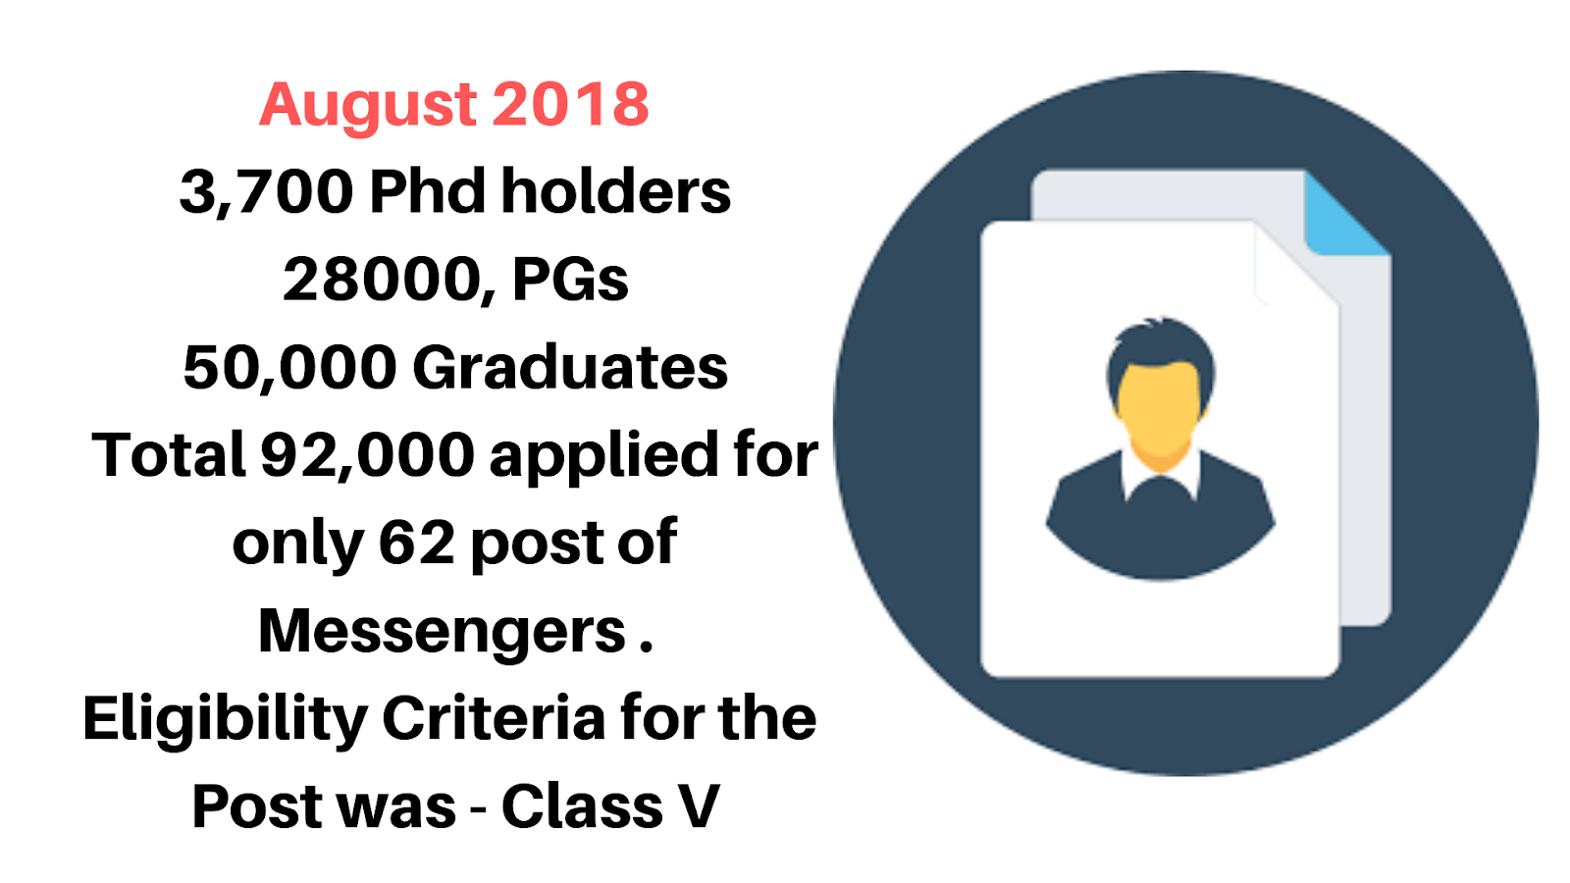
Some Horrible News…
3.

Slide 4
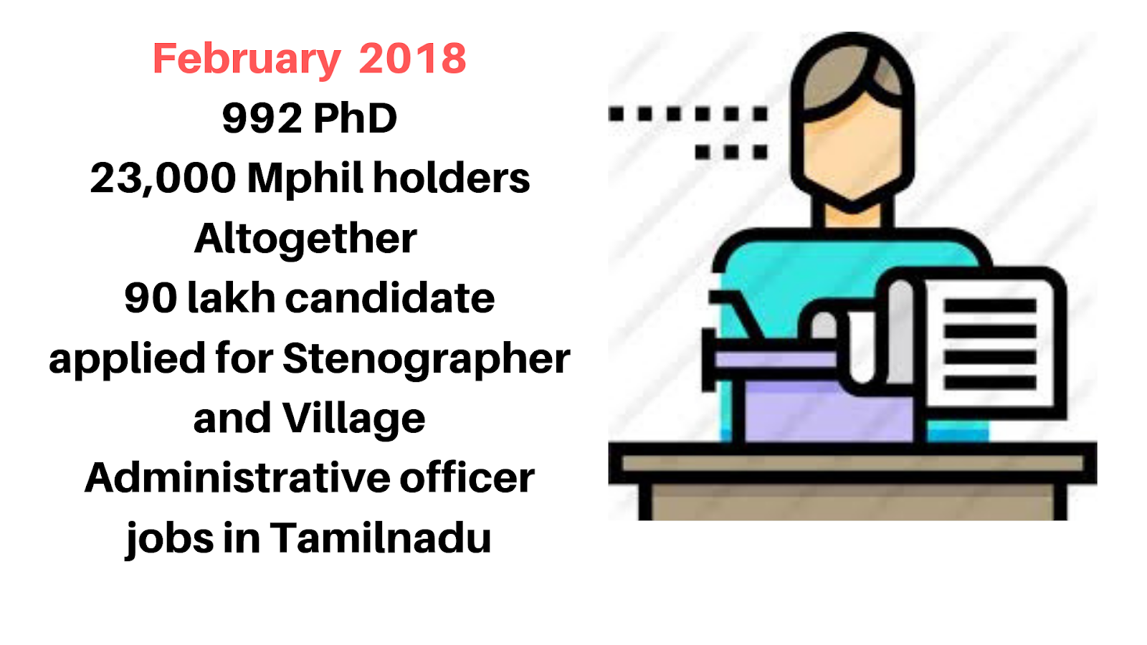
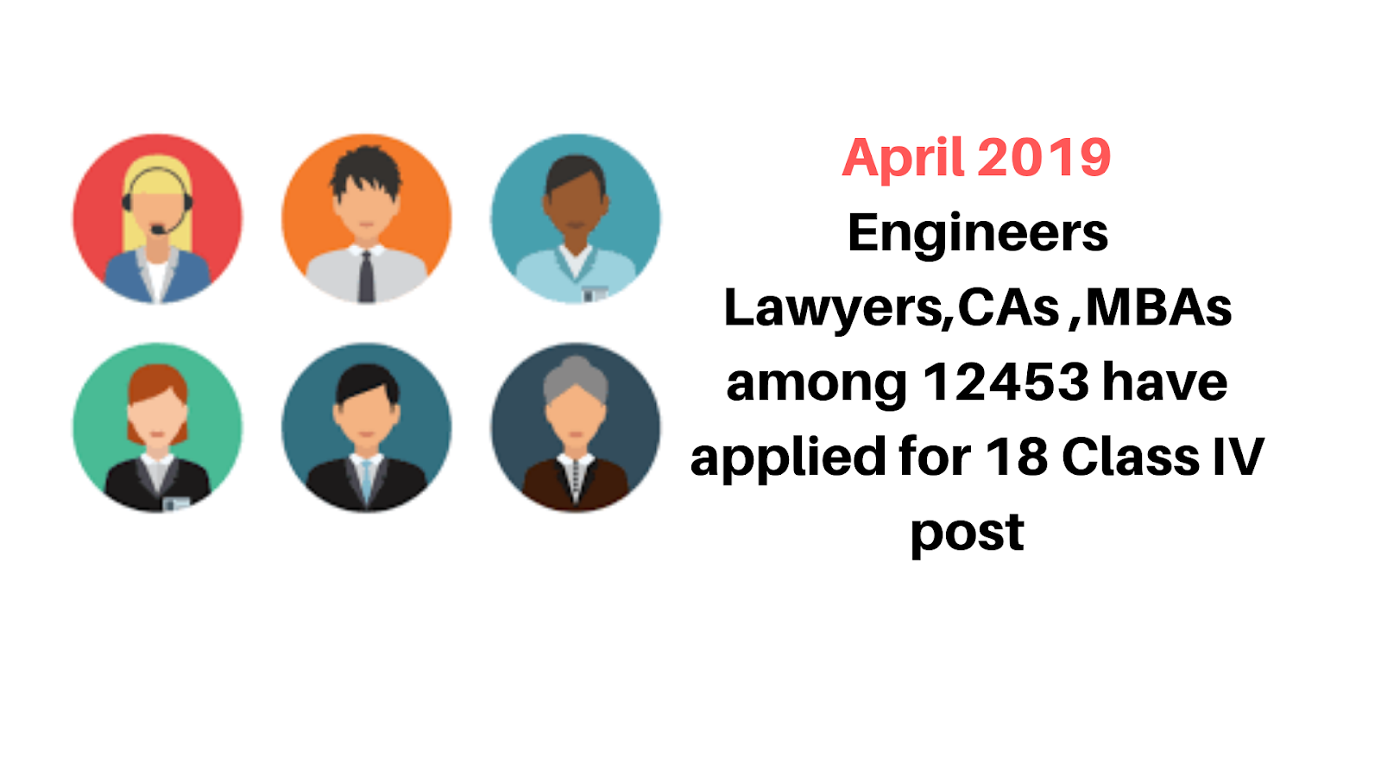
Facts:
Among all regions, East Asia has the largest number of unemployed workers.
India accounts for one in every six jobless people throughout the developing world.
5.

Slide 5
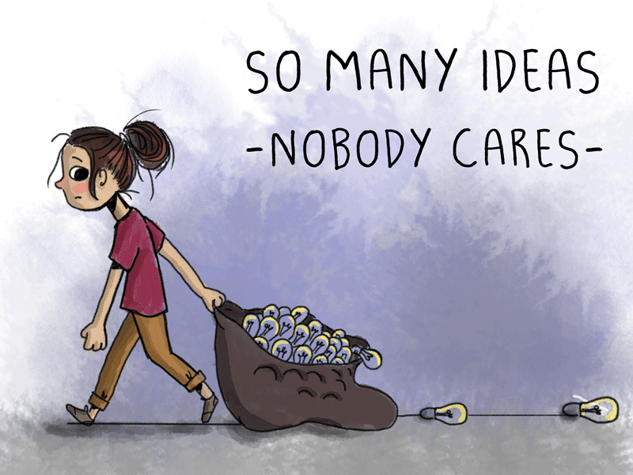
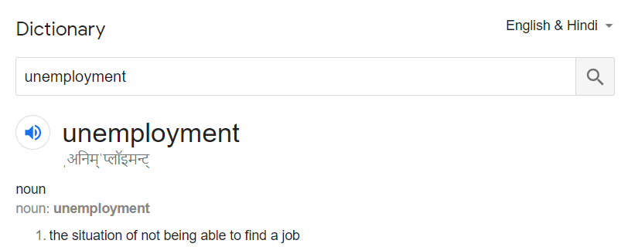
Definition: (dictionary)
Definition:
Unemployment refers to a situation in which the workers who are capable of working and willing to work do not get employed.
6.

Slide 6

Measurement of Unemployment
Economists typically focus on the unemployment rate. The unemployment rate is expressed as a percentage, and is calculated as follows:
Unemployed Workers
Unemployment Rate =
*100
Total Labor Force
Where,
Unemployed Workers =People, those are unemployed.
Total Labor Force =People, those are capable of doing work,
( Including employed and unemployed )
7.

Slide 7
Types of Unemployment
People can face unemployment for various reasons. Generally unemployment can be broken down into 5 types.
1.
2.
3.
4.
5.
Frictional
Seasonal
Structural
Disguised
Technological
8.

Slide 8
Types of Unemployment
People can face unemployment for various reasons. Generally unemployment can be broken down into 5 types.
1.
2.
3.
4.
5.
Frictional
Seasonal
Structural
Disguised
Technological
9.

Slide 9
Types of Unemployment
People can face unemployment for various reasons. Generally unemployment can be broken down into 5 types.
1.
2.
3.
4.
5.
Frictional
Seasonal
Structural
Disguised
Technological
10.

Slide 10
Types of Unemployment
People can face unemployment for various reasons. Generally unemployment can be broken down into 5 types.
1.
2.
3.
4.
5.
Frictional
Seasonal
Structural
Disguised
Technological
11.

Slide 11
Types of Unemployment
People can face unemployment for various reasons. Generally unemployment can be broken down into 5 types.
1.
2.
3.
4.
5.
Frictional
Seasonal
Structural
Disguised
Technological
12.

Slide 12
Types of Unemployment
People can face unemployment for various reasons. Generally unemployment can be broken down into 5 types.
1.
2.
3.
4.
5.
Frictional
Seasonal
Structural
Disguised
Technological
13.

Slide 13
1.
2.
3.
4.
5.
Frictional
Seasonal
Structural
Disguised
Technological
Frictional Unemployment:
Temporary phenomenon.
Results when some workers are temporarily out of the work while changing the job.
Also when work is suspended due to strike.
Its due to imperfect mobility of Laboure's.
1
14.

Slide 14
1.
2.
3.
4.
5.
Frictional
Seasonal
Structural
Disguised
Technological
Seasonal Unemployment:
Frictional Unemployment:
People engaged in such type of work or activities may remain unemployed during off-season.
Provides job of seasonal nature.
Ex. Freelancing, agriculture etc.
Temporary phenomenon.
Results when some workers are temporarily out of the work while changing the job.
Also when work is suspended due to strike.
Its due to imperfect mobility of Laboure's.
2
1
15.

Slide 15
1.
2.
3.
4.
5.
Frictional
Seasonal
Structural
Disguised
Technological
Structural Unemployment:
Seasonal Unemployment:
This unemployment arises when there is a mismatch between the worker’s skills and availability of jobs in the market.
Person may go out of job or remain unemployed.
One remain unemployed until he acquires new skills.
People engaged in such type of work or activities may remain unemployed during off-season.
Provides job of seasonal nature.
Ex. Freelancing, agriculture etc.
3
2
16.

Slide 16
1.
2.
3.
4.
5.
Frictional
Seasonal
Structural
Disguised
Technological
Disguised Unemployment:
Structural Unemployment:
When some workers have zero marginal productivity so that removal will not affect the volume of total output.
Basically overcrowding lead this type of unemployment.
This unemployment arises when there is a mismatch between the worker’s skills and availability of jobs in the market.
Person may go out of job or remain unemployed.
One remain unemployed until he acquires new skills.
4
3
17.

Slide 17
1.
2.
3.
4.
5.
Frictional
Seasonal
Structural
Disguised
Technological
Technological Unemployment:
Disguised Unemployment:
Due to introduction of new machinery, improvement in methods of production, labor-saving devices etc. some workers tend to be replaced by machines.
When some workers have zero marginal productivity so that removal will not affect the volume of total output.
Basically overcrowding lead this type of unemployment.
5
4
18.

Slide 18
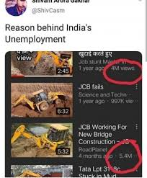
Statistical Data
Source: Ahseeit.com
19.

Slide 19
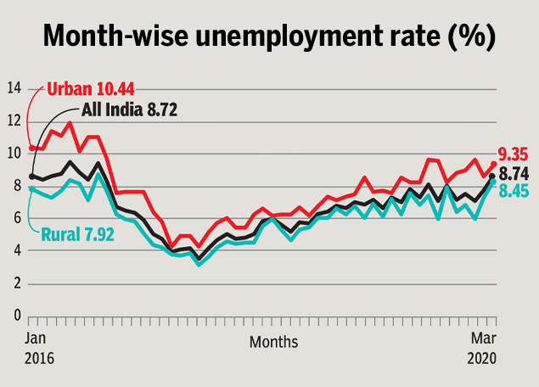
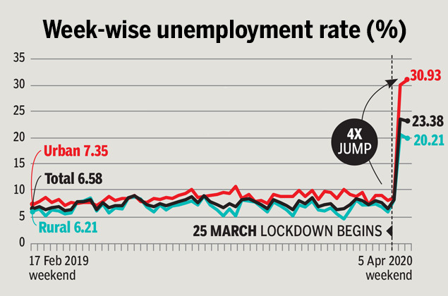
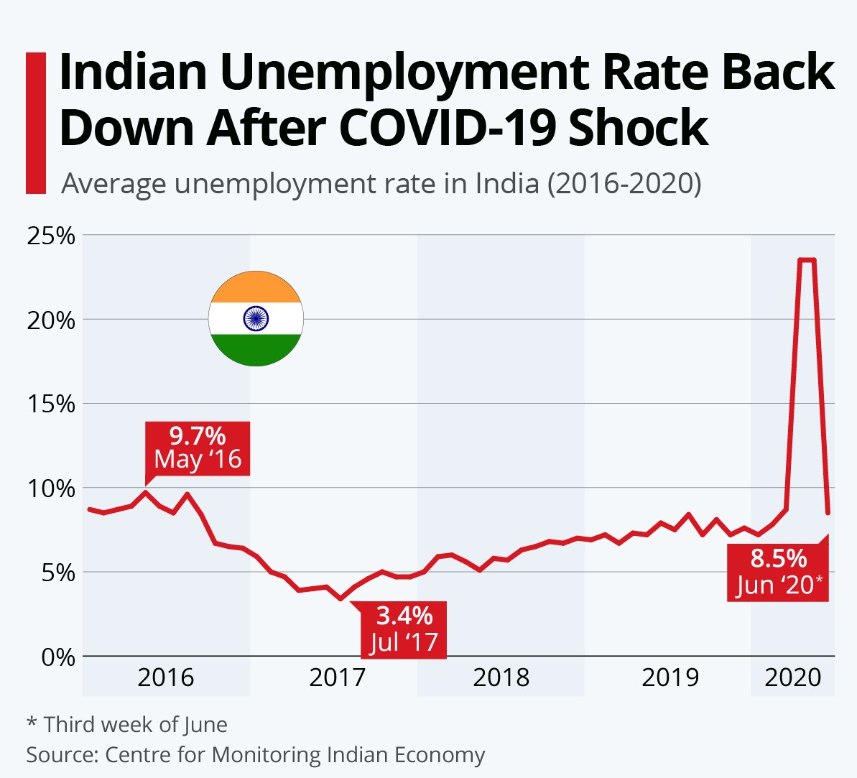
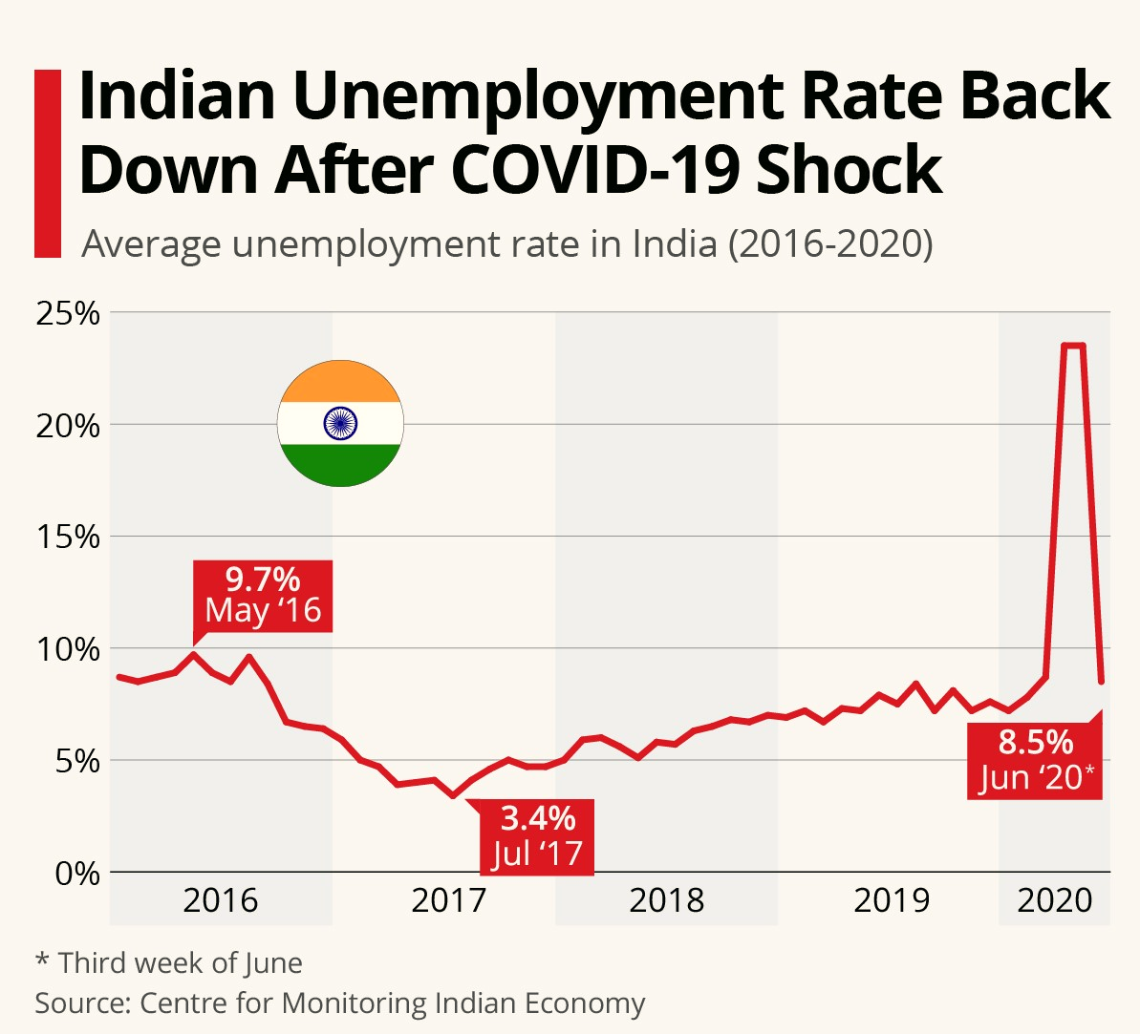
1.Month-wise rate
2.Week-wise rate
3.After COVID-19 rate
20.

Slide 20
1.Month-wise rate
2.Week-wise rate
3.After COVID-19 rate
21.

Slide 21
1.Month-wise rate
2.Week-wise rate
3.After COVID-19 rate
22.

Slide 22
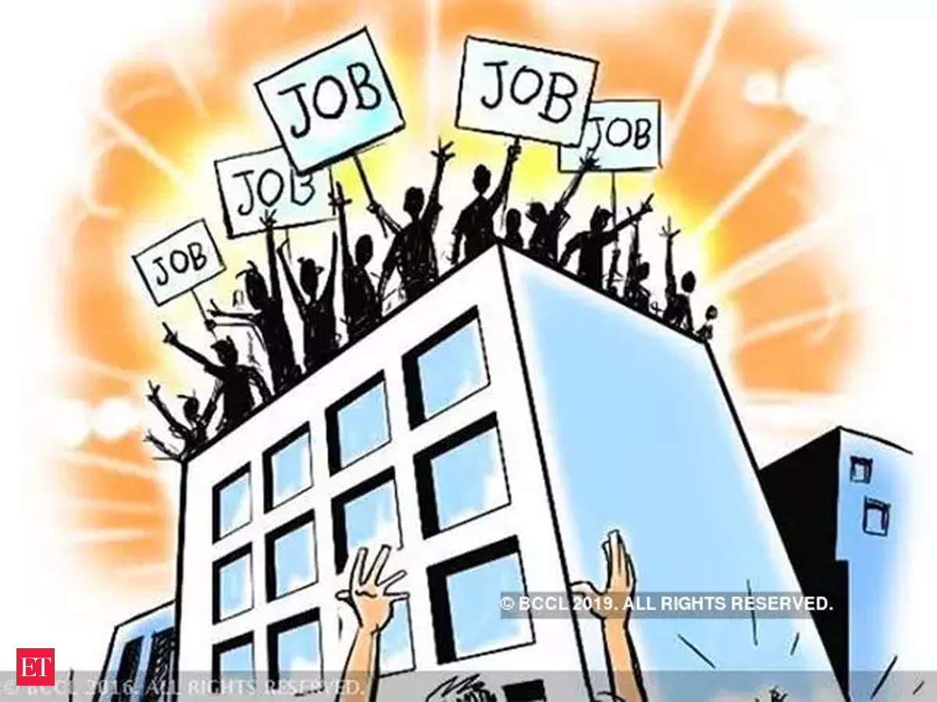
Causes of Unemployment
Source: economic times
23.

Slide 23
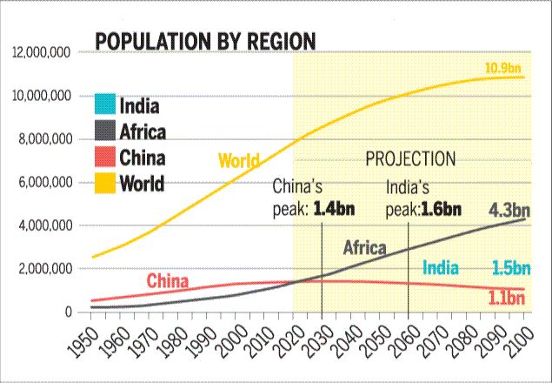
Causes of Unemployment…
1. Illiteracy
2. Rapid Population growth
3. Demand for highly skilled labours.
4. Global competition.
5. Changing Technology.
6. Economic Inflation.
24.

Slide 24
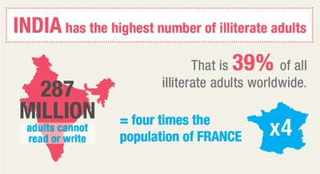
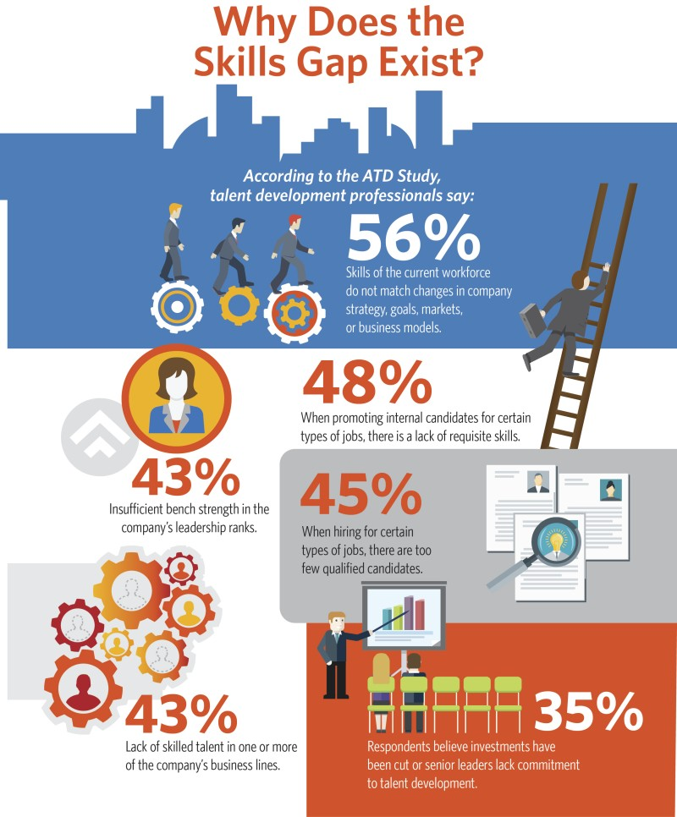
Causes of Unemployment…
25.

Slide 25
Role of Government
26.

Slide 26
Policies…
NREGA :
Enacted in 2005 as a job guarantee scheme
Launched on February 2, 2006, implemented in a phased manner
Gram Panchayat (No contractors)
Rs 30,000 crores has been allocated as budget for NREGA in 2012 – 2013.
100 day scheme
If work is not provided within 15 days of applying, applicants are entitled to an unemployment allowance.
Corruption
Economists opinion
1
27.

Slide 27
Policies…
Prime Minister Employment Generation Programme:
GRAM SWAROZGAR YOJANA:
Prime Minister’s Employment Generation Programme (PMEGP) came into effect by merging the two schemes that were in operation till 31.03.2008 namely Prime Minister's Rozgar Yojana (PMRY) & Rural Employment Generation Programme(REGP).
PMEGP is a central sector scheme administered by the Ministry of Micro, Small and Medium Enterprises (MoMSME).
Objective of providing self-Employment to Educated Unemployed youth and to develop entrepreneurial skill and attitude among rural & urban unemployed youth. Also to achieve the goal of rural & urban industrialization. Manual work at the statutory minimum wage.
Launched as an integrated program for self-employment of the rural poor with effect from 1 April 1999.
The objective of the scheme is to bring the assisted poor families above the poverty line by organizing them into Self Help Groups (SHGs).
The focus of the program is on establishing a large number of microenterprises in rural areas with the help of self help group manual work at the statutory minimum wage.
3
2
28.

Slide 28
Actions that can be taken
(suggestions..)
Better Education
Increase access to credit to encourage entrepreneurship.
Provide incentives for new initiatives .
Publicize opportunities in the media.
Accelerating Investment in Agriculture.
Removing Skill gap.
29.

Slide 29

Watch What We can Do
Watch What We can Do
A skills gap is the difference between skills that employers want or need, and skills their workforce offer. Conducting a skills gap analysis helps you identify skills you need to meet your business goals. It can also inform your employee development and hiring programs.
Know More
30.

Slide 30
References:
www.traidingeconomy.com
www.Wikipedia.com
www.youtube.com
www.drishtias.com
Graphs: stastista.com
31.
1.

Slide 31
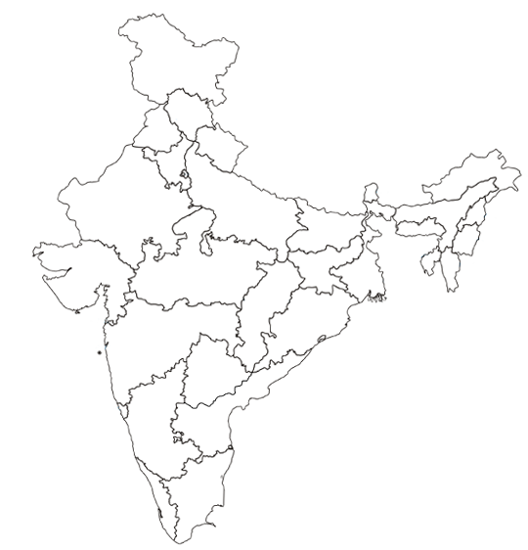

32.

